Slide 1
Sudoku Solver
11.06.2018
Magson Gao, Shreeyam Kacker
Notes:
Both

Slide 2
Sudoku Primer
Project Description
What is Sudoku?
Why FPGA?
Fill 9x9
Grid with
81 × 1-9
Techniques?
Parallelism
Candidate Line, Naked and Hidden Groups
Notes:
Shreeyam

Slide 3

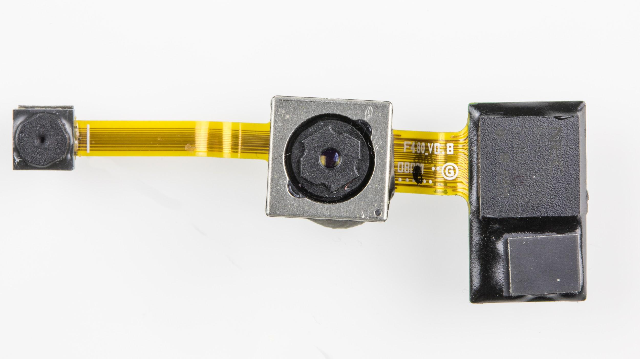
Human Techniques
Single position and single candidate
Candidate line
Hidden group
Many more… (but only we have 8 minutes)
Goals
Solve Sudoku using human techniques
Read Sudoku using a camera
Stretch Goal: include a tutorial mode which displays the steps for any solve
Notes:
Magson

Slide 4
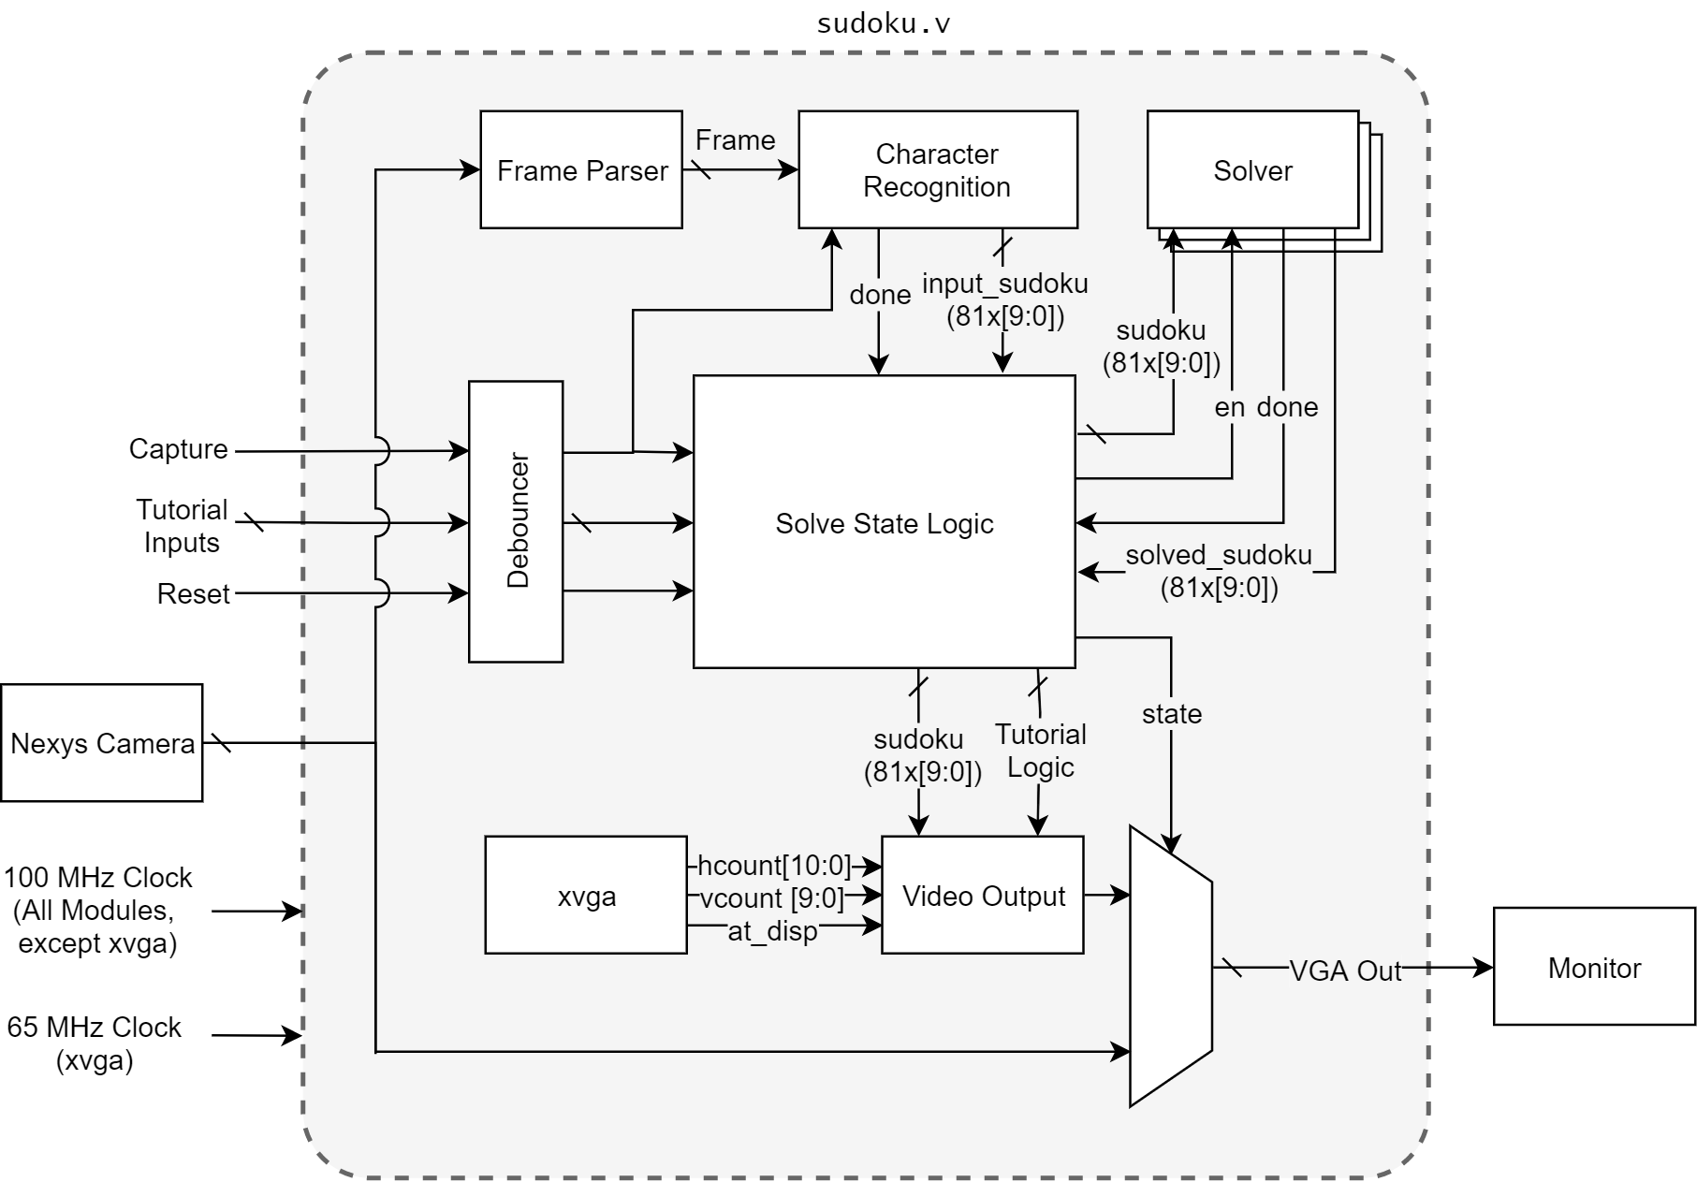
Block Diagram
Blocks of Interest
Frame Parser
Character Recognition
Solver
Notes:
Shreeyam

Slide 5
Frame Parsing
Reducing the number of gates for Character Recognition
Calculate Threshold
Convert to Black and White
Mean
Intensity
Of Pixels
Resize
1
Comparator per pixel
Majority Encoder
Notes:
Shreeyam

Slide 6
Character Recognition
Template Matching
Store flattened B/W values of #s
Compare with processed frames
ROM size:
9×
pixels/char
(bits)
Select
9 XOR operations/cycle
9 result
registers
Comparison operation using LUTs
Notes:
Shreeyam

Slide 7
Solving a Sudoku
Notes:
Magson

Slide 8
Keywords
 |  |  | 2 | 6 |  | 7 |  | 1
6 | 8 |  | 7 |  |  |  | 9
1 | 9 |  |  |  | 4 | 5
8 | 2 |  | 1 |  |  |  | 4
 |  | 4 | 6 |  | 2 | 9
 | 5 |  |  |  | 3 |  | 2 | 8
 |  | 9 | 3 |  |  |  | 7 | 4
 | 4 |  |  | 5 |  |  | 3 | 6
7 |  | 3 |  | 1 | 8
Squares
Rows
Columns
Notes:
Magson

Slide 9
Single Candidate/Position
Notes:
Magson

Slide 10
 |  |  | 2 | 6 |  | 7 |  | 1
6 | 8 |  | 7 |  |  |  | 9
1 | 9 |  |  |  | 4 | 5
8 | 2 |  | 1 |  |  |  | 4
 |  | 4 | 6 |  | 2 | 9
 | 5 |  |  |  | 3 |  | 2 | 8
 |  | 9 | 3 |  |  |  | 7 | 4
 | 4 |  |  | 5 |  |  | 3 | 6
7 |  | 3 |  | 1 | 8
What can go here?
1,2,3,4,5,6,7,8,9

Slide 11
 |  |  | 2 | 6 |  | 7 |  | 1
6 | 8 |  | 7 |  |  |  | 9
1 | 9 |  |  |  | 4 | 5
8 | 2 |  | 1 |  |  |  | 4
 |  | 4 | 6 |  | 2 | 9
 | 5 |  |  |  | 3 |  | 2 | 8
 |  | 9 | 3 |  |  |  | 7 | 4
 | 4 |  |  | 5 |  |  | 3 | 6
7 |  | 3 |  | 1 | 8
What can go here?
1,2,3,4,5,6,7,8,9
Notes:
Magson

Slide 12
 |  |  | 2 | 6 |  | 7 |  | 1
6 | 8 |  | 7 |  |  |  | 9
1 | 9 |  |  |  | 4 | 5
8 | 2 |  | 1 |  |  |  | 4
 |  | 4 | 6 |  | 2 | 9
 | 5 |  |  |  | 3 |  | 2 | 8
 |  | 9 | 3 |  |  |  | 7 | 4
 | 4 |  |  | 5 |  |  | 3 | 6
7 |  | 3 |  | 1 | 8
What can go here?
1,2,3,4,5,6,7,8,9
Notes:
Magson

Slide 13
 |  |  | 2 | 6 |  | 7 |  | 1
6 | 8 |  | 7 |  |  |  | 9
1 | 9 |  |  |  | 4 | 5
8 | 2 |  | 1 |  |  |  | 4
 |  | 4 | 6 |  | 2 | 9
 | 5 |  |  |  | 3 |  | 2 | 8
 |  | 9 | 3 |  |  |  | 7 | 4
 | 4 |  |  | 5 |  |  | 3 | 6
7 |  | 3 |  | 1 | 8
What can go here?
1,2,3,4,5,6,7,8,9
Notes:
Magson

Slide 14
 |  |  | 2 | 6 |  | 7 |  | 1
6 | 8 |  | 7 |  |  |  | 9
1 | 9 |  |  |  | 4 | 5
8 | 2 |  | 1 |  |  |  | 4
 |  | 4 | 6 |  | 2 | 9
 | 5 |  |  |  | 3 |  | 2 | 8
 |  | 9 | 3 |  |  |  | 7 | 4
 | 4 |  |  | 5 |  |  | 3 | 6
7 |  | 3 |  | 1 | 8
What can go here?
1,2,3,4,5,6,7,8,9
Notes:
Magson

Slide 15
 |  |  | 2 | 6 |  | 7 |  | 1
6 | 8 |  | 7 |  |  |  | 9
1 | 9 |  |  |  | 4 | 5
8 | 2 |  | 1 |  |  |  | 4
 |  | 4 | 6 |  | 2 | 9
 | 5 |  |  |  | 3 |  | 2 | 8
 |  | 9 | 3 |  |  |  | 7 | 4
 | 4 |  |  | 5 |  |  | 3 | 6
7 |  | 3 |  | 1 | 8
What can go here?
1,2,3,4,5,6,7,8,9
Notes:
Magson

Slide 16
 |  |  | 2 | 6 |  | 7 |  | 1
6 | 8 |  | 7 |  |  |  | 9
1 | 9 |  |  |  | 4 | 5
8 | 2 |  | 1 |  |  |  | 4
 |  | 4 | 6 |  | 2 | 9
 | 5 |  |  |  | 3 |  | 2 | 8
 |  | 9 | 3 |  |  |  | 7 | 4
 | 4 |  |  | 5 |  |  | 3 | 6
7 |  | 3 |  | 1 | 8
What can go here?
1,2,3,4,5,6,7,8,9
Notes:
Magson

Slide 17
 |  |  | 2 | 6 |  | 7 |  | 1
6 | 8 |  | 7 |  |  |  | 9
1 | 9 |  |  |  | 4 | 5
8 | 2 |  | 1 |  |  |  | 4
 |  | 4 | 6 |  | 2 | 9
 | 5 |  |  |  | 3 |  | 2 | 8
 |  | 9 | 3 |  |  |  | 7 | 4
 | 4 |  |  | 5 |  |  | 3 | 6
7 |  | 3 |  | 1 | 8
What can go here?
1,2,3,4,5,6,7,8,9
Notes:
Magson

Slide 18
 |  |  | 2 | 6 |  | 7 |  | 1
6 | 8 |  | 7 |  |  |  | 9
1 | 9 |  |  |  | 4 | 5
8 | 2 |  | 1 |  |  |  | 4
 |  | 4 | 6 |  | 2 | 9
 | 5 |  |  |  | 3 |  | 2 | 8
 |  | 9 | 3 |  |  |  | 7 | 4
 | 4 |  |  | 5 |  |  | 3 | 6
7 |  | 3 |  | 1 | 8
What can go here?
1,2,3,4,5,6,7,8,9
5 is the Single Candidate
Notes:
Magson

Slide 19
 |  |  | 2 | 6 |  | 7 |  | 1
6 | 8 |  | 7 |  |  |  | 9
1 | 9 |  |  |  | 4 | 5
8 | 2 |  | 1 |  |  |  | 4
 |  | 4 | 6 |  | 2 | 9
 | 5 |  |  |  | 3 |  | 2 | 8
 |  | 9 | 3 |  |  |  | 7 | 4
 | 4 |  |  | 5 |  |  | 3 | 6
7 |  | 3 |  | 1 | 8 |  | 5
Where can 9 go?
Notes:
Magson

Slide 20
 |  |  | 2 | 6 |  | 7 |  | 1
6 | 8 |  | 7 |  |  |  | 9
1 | 9 |  |  |  | 4 | 5
8 | 2 |  | 1 |  |  |  | 4
 |  | 4 | 6 |  | 2 | 9
 | 5 |  |  |  | 3 |  | 2 | 8
 |  | 9 | 3 |  |  |  | 7 | 4
 | 4 |  |  | 5 |  |  | 3 | 6
7 |  | 3 |  | 1 | 8 |  | 5
Where can 9 go?
This is the Single Position
Notes:
Magson

Slide 21

How can a bunch of gates do Sudoku?
One-hot Representation
Simplifies logic significantly
Empty Cells = 0
Determining single candidates is a simple AND operation with masks of possible values
Determining single positions is a NOR and AND operation between masks
Notes:
Magson

Slide 22
 |  |  | 2 | 6 |  | 7 |  | 1
6 | 8 |  | 7 |  |  |  | 9
1 | 9 |  |  |  | 4 | 5
8 | 2 |  | 1 |  |  |  | 4
 |  | 4 | 6 |  | 2 | 9
 | 5 |  |  |  | 3 |  | 2 | 8
 |  | 9 | 3 |  |  |  | 7 | 4
 | 4 |  |  | 5 |  |  | 3 | 6
7 |  | 3 |  | 1 | 8
What can go here?
Notes:
Magson

Slide 23
 |  |  | 2 | 6 |  | 7 |  | 1
6 | 8 |  | 7 |  |  |  | 9
1 | 9 |  |  |  | 4 | 5
8 | 2 |  | 1 |  |  |  | 4
 |  | 4 | 6 |  | 2 | 9
 | 5 |  |  |  | 3 |  | 2 | 8
 |  | 9 | 3 |  |  |  | 7 | 4
 | 4 |  |  | 5 |  |  | 3 | 6
7 |  | 3 |  | 1 | 8
What can go here?
987654321
9= 100000000
4= 000001000
2= 000000010
7= 001000000
3= 000000100
|= 101001110
~= 010110001
8,6,5 or 1
Notes:
Magson

Slide 24
 |  |  | 2 | 6 |  | 7 |  | 1
6 | 8 |  | 7 |  |  |  | 9
1 | 9 |  |  |  | 4 | 5
8 | 2 |  | 1 |  |  |  | 4
 |  | 4 | 6 |  | 2 | 9
 | 5 |  |  |  | 3 |  | 2 | 8
 |  | 9 | 3 |  |  |  | 7 | 4
 | 4 |  |  | 5 |  |  | 3 | 6
7 |  | 3 |  | 1 | 8
What can go here?
987654321
7= 001000000
3= 000000100
1= 000000001
8= 010000000
|= 011000101
~= 100111010 not 1 and not 8
& 010110001
= 000110000
Notes:
Magson

Slide 25
 |  |  | 2 | 6 |  | 7 |  | 1
6 | 8 |  | 7 |  |  |  | 9
1 | 9 |  |  |  | 4 | 5
8 | 2 |  | 1 |  |  |  | 4
 |  | 4 | 6 |  | 2 | 9
 | 5 |  |  |  | 3 |  | 2 | 8
 |  | 9 | 3 |  |  |  | 7 | 4
 | 4 |  |  | 5 |  |  | 3 | 6
7 |  | 3 |  | 1 | 8
What can go here?
987654321
7= 001000000
4= 000001000
3= 000000100
6= 000100000
|= 001101100
~= 110010011
& 000110000
Must be a 5
Notes:
Magson

Slide 26

Hidden Group Setup
Suppose we have N numbers which can only be placed in N positions
Then all N positions must contain one of the N numbers.
Notes:
Shreeyam

Slide 27
8 | 2,5 | 1 | 2,7 | 3,5 | 6 | 3,7 | 9 | 4
3 | 2,5 | 4,6 | 2,4,7 | 1,5 | 9 | 1,6,7 | 8 | 1,2,7
4,9 | 7 | 4,6 | 2,4 | 8 | 1,3 | 5 | 2,6 | 1,2,3
5 | 4 | 7 | 8,9 | 6 | 2 | 1,8 | 3 | 1,9
6 | 3 | 2 | 8,9 | 1,4 | 1,4 | 7,8 | 5 | 7,9
1 | 9 | 8 | 3 | 7 | 5 | 2 | 4 | 6
4,7 | 8 | 3 | 6 | 2 | 4,7 | 9 | 1 | 5
4,7 | 6 | 5 | 1 | 9 | 8 | 3,4,7 | 2,7 | 2,3,7
2 | 1 | 9 | 5 | 3,4 | 3,4,7 | 4,6,7 | 6,7 | 8
What can’t go here?
The empty cells contain the possible values:
{4,9}
{4,6}
{2,4}
{1,3}
{2,6}
{1,2,3}
We have only 2 places where 1 and 3 can go, so it is impossible for 2 to be in the last cell
-> {1,3}
Notes:
Shreeyam

Slide 28

The digital algorithm very cool! The Q&A is coming up *wink* *wink*
Notes:
*silence*

Slide 29
Project Timeline
Notes:
Shreeyam

Slide 30
Key Dates
Verification and Validation of connected system
Project Submission
Week
2
Week
3
Week
6
Solve Medium/Hard Sudokus Using Hidden Group and Single Candidate/Position
Have Camera Working
Attempt to
Implement Backtracking
Attempt to
Implement Tutorial Mode
Code Polished
Notes:
Shreeyam

Slide 31
Thank you for your attention
11.06.2018
Magson Gao, Shreeyam Kacker
Notes:
Both

Slide 32
8 | 2,5 | 1 | 2,7 | 3,5 | 6 | 3,7 | 9 | 4
3 | 2,5 | 4,6 | 2,4,7 | 1,5 | 9 | 1,6,7 | 8 | 1,2,7
4,9 | 7 | 4,6 | 2,4 | 8 | 1,3 | 5 | 2,6 | 1,2,3
5 | 4 | 7 | 8,9 | 6 | 2 | 1,8 | 3 | 1,9
6 | 3 | 2 | 8,9 | 1,4 | 1,4 | 7,8 | 5 | 7,9
1 | 9 | 8 | 3 | 7 | 5 | 2 | 4 | 6
4,7 | 8 | 3 | 6 | 2 | 4,7 | 9 | 1 | 5
4,7 | 6 | 5 | 1 | 9 | 8 | 3,4,7 | 2,7 | 2,3,7
2 | 1 | 9 | 5 | 3,4 | 3,4,7 | 4,6,7 | 6,7 | 8
What can’t go here?
The empty cells contain the possible values: 987654321
{4,9} = 100001000
{4,6} = 000101000
{2,4} = 000001010
{1,3} = 000000101
{2,6} = 000100010
{1,2,3} = 000000111
In this algorithm we iterate over each set
Notes:
Magson

Slide 33
8 | 2,5 | 1 | 2,7 | 3,5 | 6 | 3,7 | 9 | 4
3 | 2,5 | 4,6 | 2,4,7 | 1,5 | 9 | 1,6,7 | 8 | 1,2,7
4,9 | 7 | 4,6 | 2,4 | 8 | 1,3 | 5 | 2,6 | 1,2,3
5 | 4 | 7 | 8,9 | 6 | 2 | 1,8 | 3 | 1,9
6 | 3 | 2 | 8,9 | 1,4 | 1,4 | 7,8 | 5 | 7,9
1 | 9 | 8 | 3 | 7 | 5 | 2 | 4 | 6
4,7 | 8 | 3 | 6 | 2 | 4,7 | 9 | 1 | 5
4,7 | 6 | 5 | 1 | 9 | 8 | 3,4,7 | 2,7 | 2,3,7
2 | 1 | 9 | 5 | 3,4 | 3,4,7 | 4,6,7 | 6,7 | 8
What can’t go here?
Steps*
Add up the number of 1s of the mask we are working on (let’s call the number of 1s X and the mask we are working on Y).
AND mask Y with every other possibilities mask (this includes the ones that are solved, though these always give 0). Let us call the results of the AND operations A.
If the number of 0s in A are equal to (9-X) then a hidden group is detected
If the number of masks in A with (# of 1s = X) is equal to (X-1) a naked group exists between the Y and the masks in these positions.
For every mask in the hidden group, replace it with the mask stored in A. For every mask outside the naked group replace the mask with (mask & ~Y).
Notes:
Magson

Slide 34
8 | 2,5 | 1 | 2,7 | 3,5 | 6 | 3,7 | 9 | 4
3 | 2,5 | 4,6 | 2,4,7 | 1,5 | 9 | 1,6,7 | 8 | 1,2,7
4,9 | 7 | 4,6 | 2,4 | 8 | 1,3 | 5 | 2,6 | 1,2,3
5 | 4 | 7 | 8,9 | 6 | 2 | 1,8 | 3 | 1,9
6 | 3 | 2 | 8,9 | 1,4 | 1,4 | 7,8 | 5 | 7,9
1 | 9 | 8 | 3 | 7 | 5 | 2 | 4 | 6
4,7 | 8 | 3 | 6 | 2 | 4,7 | 9 | 1 | 5
4,7 | 6 | 5 | 1 | 9 | 8 | 3,4,7 | 2,7 | 2,3,7
2 | 1 | 9 | 5 | 3,4 | 3,4,7 | 4,6,7 | 6,7 | 8
What can’t go here?
The empty cells contain the possible values: 987654321
{4,9} = 100001000
{4,6} = 000101000
{2,4} = 000001010
{1,3} = 000000101 = Y
{2,6} = 000100010
{1,2,3} = 000000111
X = 2,
Number of masks = 0 in A = 4 + 3
Number of masks with 2✕1s = 1
->000000101
A:987654321
->000000000
->000000000
->000000000
->000000000
->000000101
*This method works for all hidden pairs and the vast majority of other worthwhile group sizes
Notes:
Example where the method fails: http://planetsudoku.com/how-to/sudoku-hidden-quint.html

Slide 35
Naked Group Setup
Suppose we have N numbers which are the only possible values for N positions
Then all N positions must contain one of the N numbers. No other position in the row/column/square can contain the N numbers.

Slide 36
8 | 2,5 | 1 | 2,7 | 3,5 | 6 | 3,7 | 9 | 4
3 | 2,5 | 4,6 | 2,4,7 | 1,5 | 9 | 1,6,7 | 8 | 1,2,7
4,9 | 7 | 4,6 | 2,4 | 8 | 1,3 | 5 | 2,6 | 1,2,3
5 | 4 | 7 | 8,9 | 6 | 2 | 1,8 | 3 | 1,9
6 | 3 | 2 | 8,9 | 1,4 | 1,4 | 7,8 | 5 | 7,9
1 | 9 | 8 | 3 | 7 | 5 | 2 | 4 | 6
4,7 | 8 | 3 | 6 | 2 | 4,7 | 9 | 1 | 5
4,7 | 6 | 5 | 1 | 9 | 8 | 3,4,7 | 2,7 | 2,3,7
2 | 1 | 9 | 5 | 3,4 | 3,4,7 | 4,6,7 | 6,7 | 8
What can’t go here?
The empty cells contain the possible values: 987654321
{4,9} = 100001000
{4,7} = 001001000 = Y
{4,7} = 001001000
X = 2,
Number of masks = 0 in A = 0 + 6
Number of masks with 2✕1s = 1
A: 987654321
-> 000001000
-> 001001000
9
{4,9} = 100001000
~Y =110110111
The 3rd cell must be a 9

